Slide 1

Face mask detection
Faculty of Information Technology
The Egyptian E-Learning University (EELU)
Graduation Project
2023-2024

Slide 2
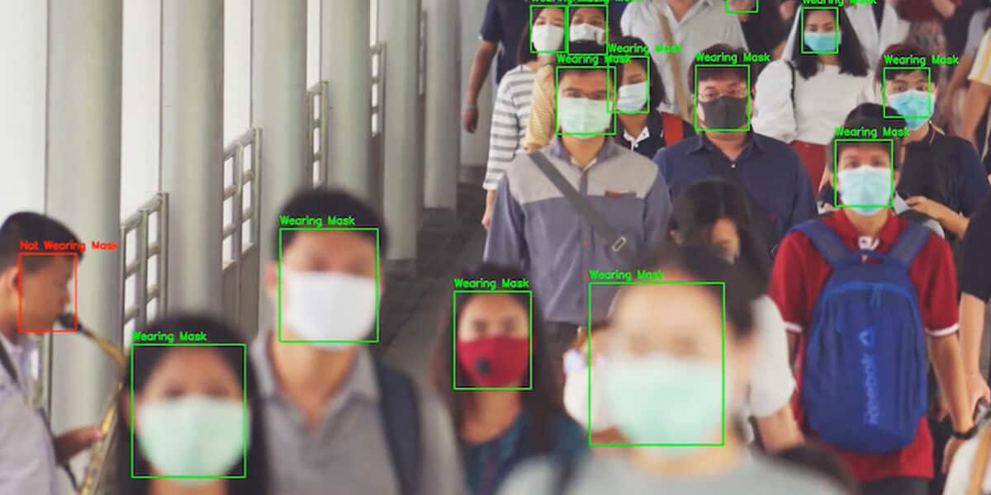
Presented by:
Taher Abdelazim Fayez - 2001364
Moatasem Mohamed Sadek - 1901304
Fady Ehab Youssef - 2000505
Ahmed Mohamed Abdellatif - 2001420
Sara Fahmy Ahmed - 2000175
Abdelrahman Galal Mohamed - 2000101
Kermina Nabil Henen - 2000156
Supervised by:
Dr. Hanaa Bauomy
Eng. Doaa Mahmoud Hassan

Slide 3
Agenda
01
Introduction
04
Implementation &
proposed method
02
Background
05
Demo
03
06
Conclusion &
future work
Related work

Slide 4
1 - Introduction
In the first phase we talk in general way about our project and we discussed about importance of our project that help us to prevent diseases like covid-19…etc in this second phase we will talk specifically about our project we will go deeper into how to improve our project and make it applicable in real life, while adding some improvements that will make it reach the greatest level of reliability to ensure its use, ease, and accuracy .
- Summarization :-
In this part we will talk briefly about what we did in first phase and what the obstacles we faced in our first phase first we applied 2 models in our project and they are ( Support Vector machine , and k-nearest neighbor ) we apply 2 machine learning algorithm but we had We encountered a lot of errors like the quality of our dataset to and the low accuracy we had because of our data Which made our project lose a degree of reliability and we will discuss later in next parts about how we improve it .

Slide 5
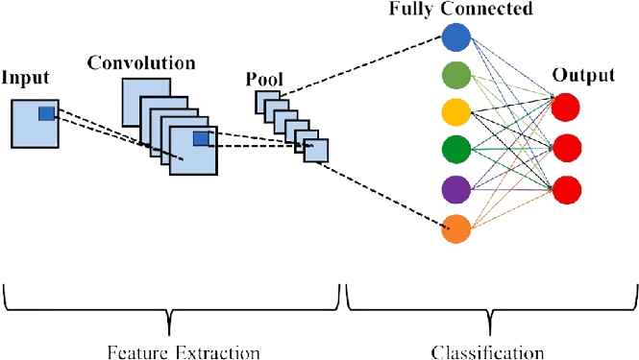
2 - BackGround
convolution neural network ( CNN )
Is a type of deep learning models used usually to analyze visual data it consist of many layers that can learn and extract features from input images effectively and it contain convolution layers and pooling layers and fully connected layers we use it in our project because it can effectively identify patterns in images such mask or not .

Slide 6
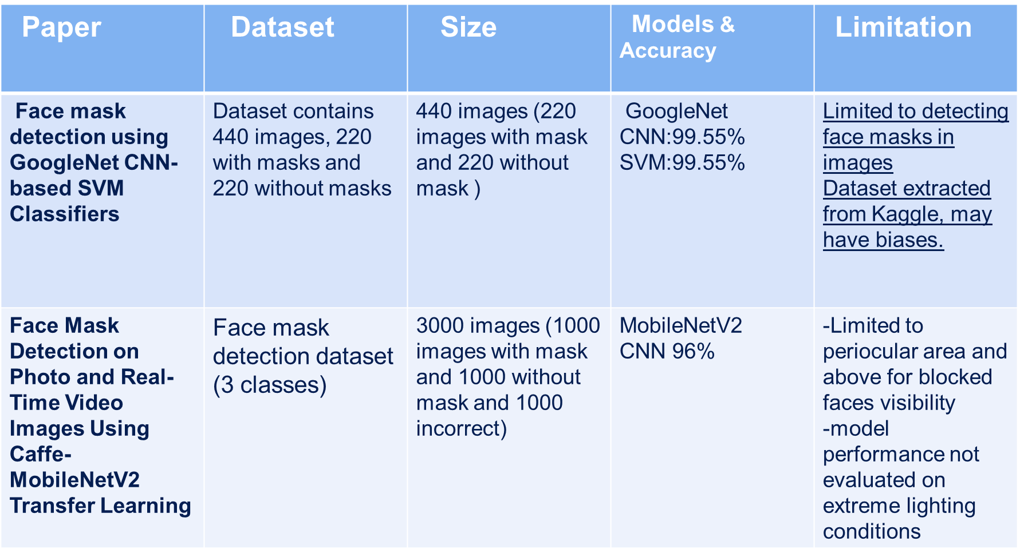
3 - Related work

Slide 7
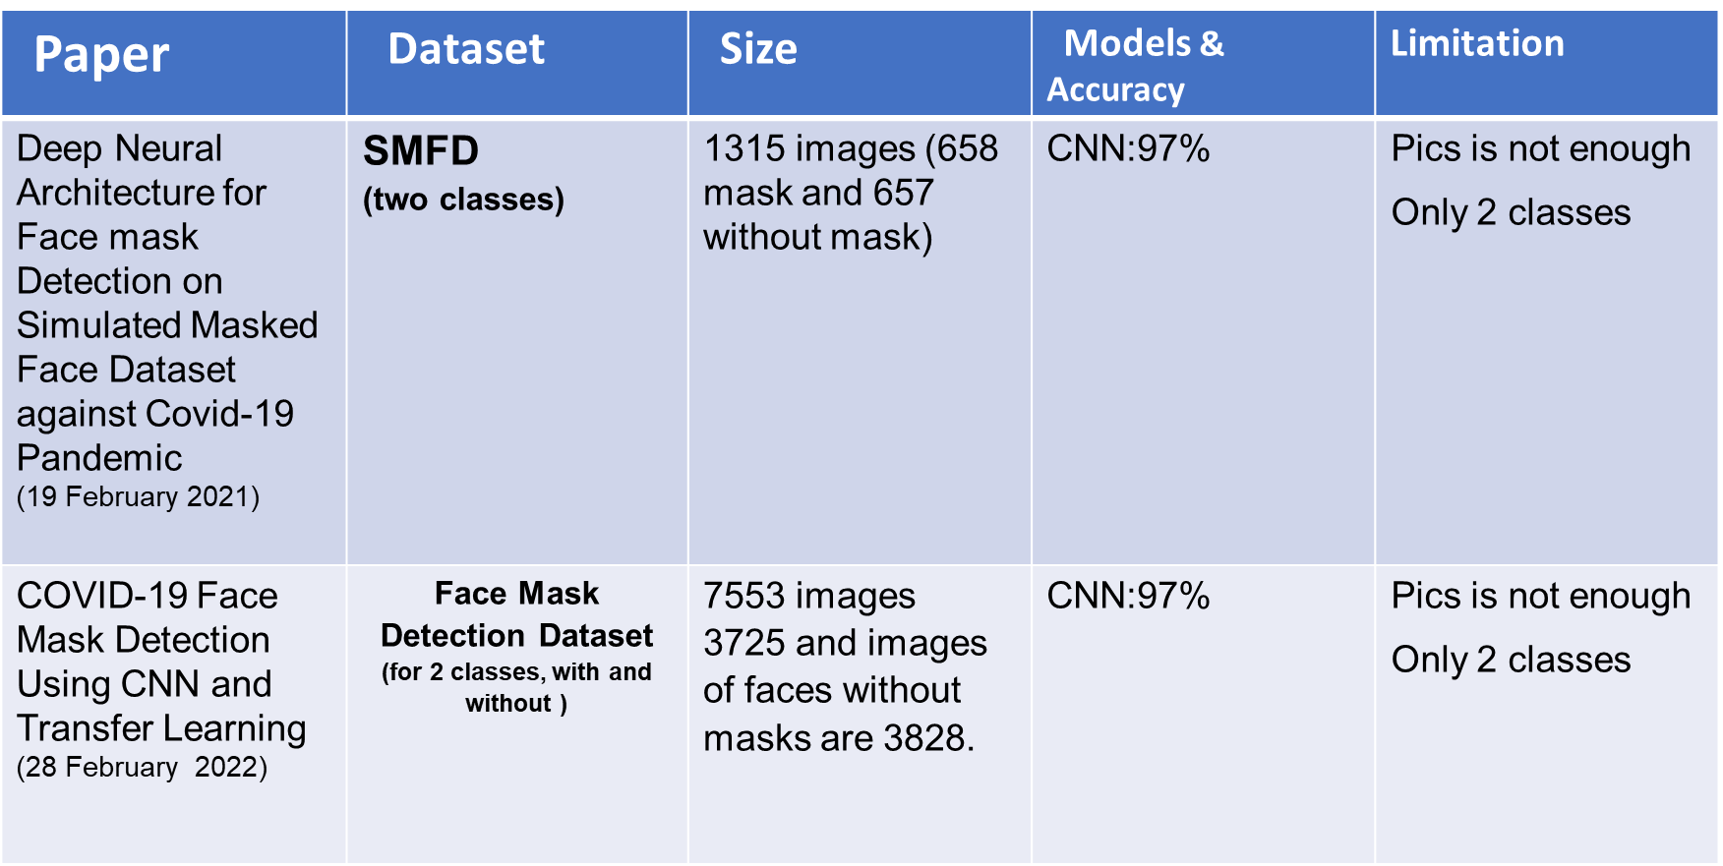
3 - Related work
Finally we use Face Mask Detection on photo and RealTime Video Images

Slide 8
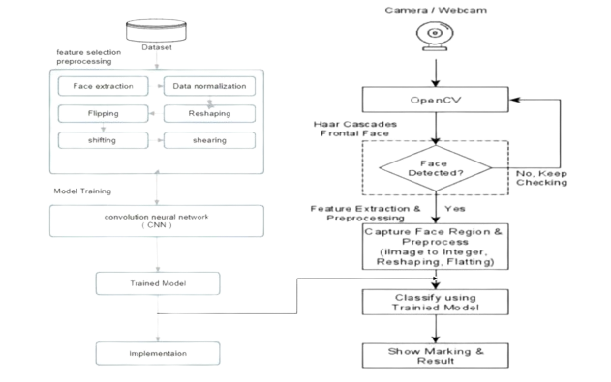
4 - implementation and proposed Method

Slide 9
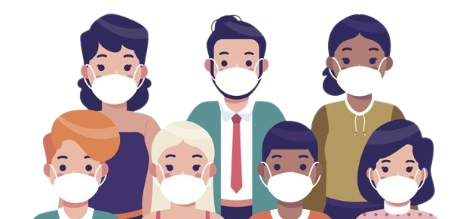
- Dataset Selection
Lets talk about data we use data with the name Face Mask Detection By Vijay Kumar The number of images in this dataset are 3000 images with and the size of them is 488 MG and split into 3 categories with mask , without , incorrect the format of images include jpg and png and we make the resolution of this data 64 × 64 and the images in RGB format

Slide 10
- Data Preprocessing
Image Loading
Rotating
Shearing
Flipping
01
02
03
04
Apply Fill Mode
Normalize
Reshaping
Data Splitiing
05
06
07
08

Slide 11
- Results Models
Support Vector Machine :-
Test Accuracy : 92.41%
K-nearest Neighbor :-
Test Accuracy : 81.78%
Convolution Neural Network :-
Test Accuracy : 96.3%

Slide 12
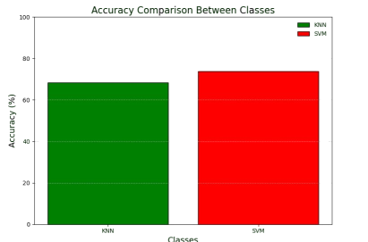
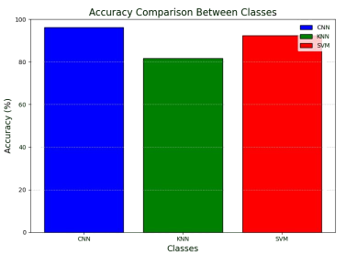
- Improvement In our Model
The Improvement In the Accuracy Make our project more realible

Slide 13
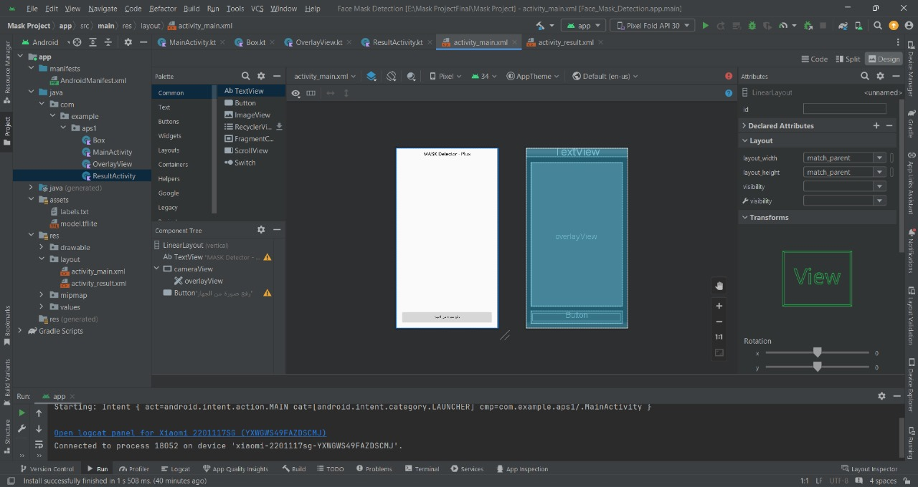
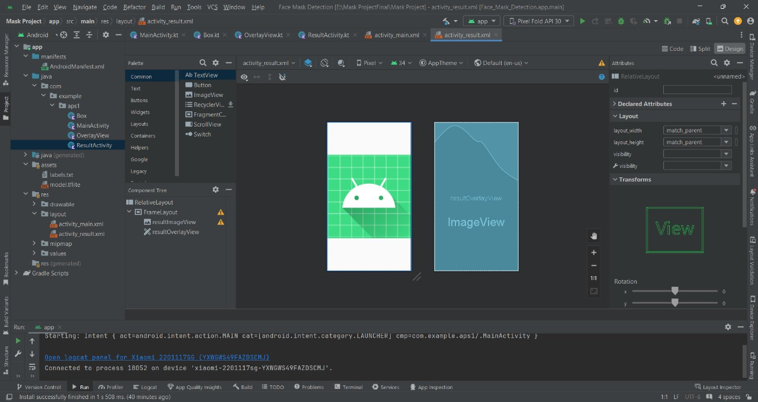
- GUI
This interface is used too operate the camera to activate the model
This file relation with (resultOverlayView)This file takes an image that is uploaded from the device files

Slide 14
- Integration Model with App
val modelFile = FileUtil.loadMappedFile(this, "model.tflite") val model = Interpreter(modelFile, Interpreter.Options()) val labels = FileUtil.loadLabels(this, "labels.txt")
Load model.tflite from assets directorty and initialize a interpreter Tf lite after this load file label that also in assets that interpret the output of model
val cropSize = kotlin.math.min(input.width, input.height) val imageProcessor = ImageProcessor.Builder() .add(ResizeWithCropOrPadOp(cropSize, cropSize)) .add(ResizeOp(inputShape[1], inputShape[2], ResizeOp.ResizeMethod.NEAREST_NEIGHBOR)) .add(NormalizeOp(127.5f, 127.5f)) .build()
// load image inputImageBuffer.load(input) inputImageBuffer = imageProcessor.process(inputImageBuffer)
Make normalization and reshape image to fit the model and making it into square and and load input image into tensor image and apply preprocessing on image

Slide 15
model.run(inputImageBuffer.buffer, outputBuffer.buffer.rewind())
Execute tenserflow model with preprocessed image and save the results in output buffer
val labelOutput = TensorLabel(labels, outputBuffer) val label = labelOutput.mapWithFloatValue return label
Making tensor label and associate it with outputbuffer with provided label and convert output values into labels names and float values
Camera Integration
App use device camera to capture frame and detect face with ‘Face detector’ and app crop the face from the frame the cropped image is processed by tenseflow lite and detect if it wears mask or not after that abounding box is drawn around each face and detect if it wearing mask or not with score top the boundry and overlay view is responsible to appear it

Slide 16
- Demo

Slide 17
- Demo

Slide 18
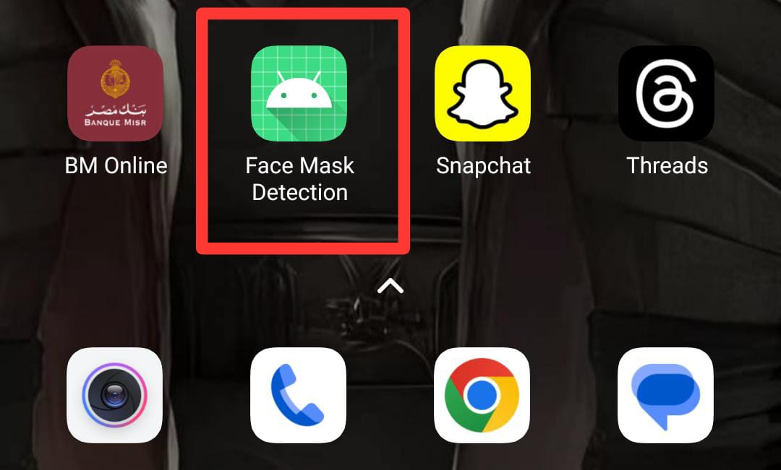
- App

Slide 19
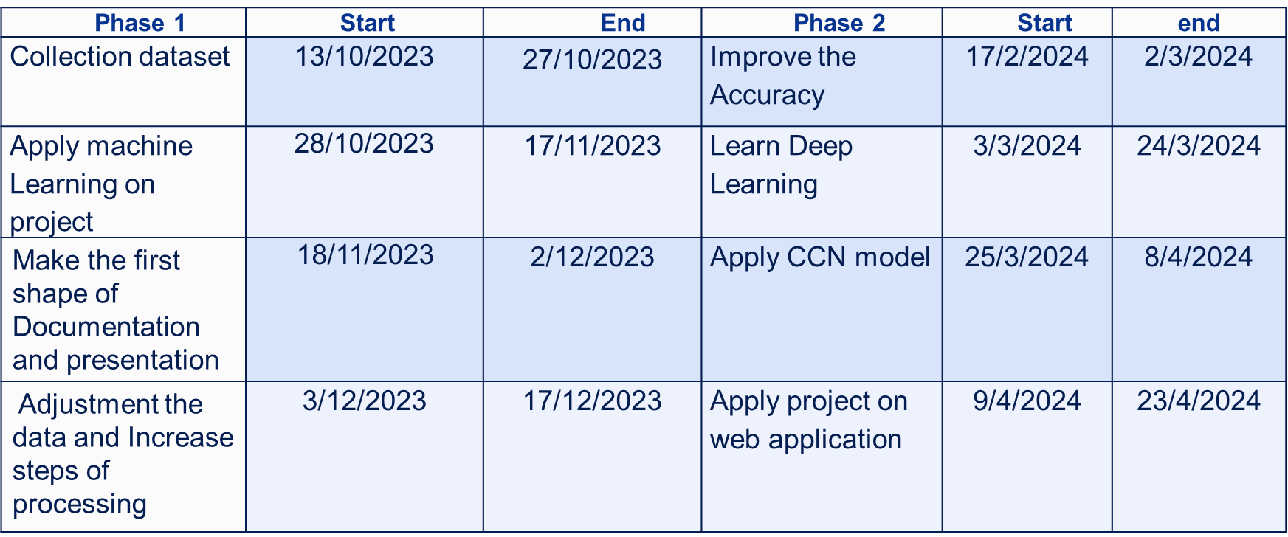
- Conclusion and Future Work
Work Plan

Slide 20
- Conclusion and Future Work
Conclusion
This pandemic has wreaked havoc on the entire world, and the world is now facing a massive health crisis as a result of the deadly disease that was declared by WHO in 2020, and governments and organizations struggled to control it before WHO issued preventive measures such as hand sanitizer, hand washing, and social distance. According to COVID-19 statistics, the transmission of the disease is higher in crowded areas, and many researchers have determined that wearing a mask in public spaces will immediately minimize the disease’s spread. As a result, governments in various countries have mandated the wearing of masks in public and crowded areas, making it extremely difficult to monitor people’s compliance with government rules, particularly in crowded areas. This is what prompted this research work, and we proposed a deep learning model that detects whether a person is wearing a mask or not. This model was created using CNN and image augmentation techniques were employed to improve the model’s performance in this study. The proposed method uses the SVM as an image classification algorithm that can detect whether an image contains a picture of people wearing or not wearing a face mask. Based on the experiments that have been conducted, the proposed method succeeded in obtaining % of accuracy, % of precision, % of recall and % of F-measure. In addition, the proposed method also shows fast computational performance.

Slide 21
- Conclusion and Future Work
Future Work :-
combine between models :Instead of relying on just one model (CNN, KNN, or SVM), you could combine their predictions using ensemble methods. Imagine your app asks each model if someone is wearing a mask, then takes a majority vote (most models agree) for the final answer. This can potentially make your app more accurate and reliable.
Robustness and Generalization: CNNs can be sensitive to small variations in input data, leading to reduced performance in real-world scenarios. Future research focuses on developing techniques to improve the robustness and generalization of CNNs, making them more reliable across different domains and datasets.
Domain-Specific Applications: CNNs have shown remarkable success in various domains, including computer vision, natural language processing, and healthcare. Future research will continue to explore domain-specific applications of CNNs, tailoring architectures and techniques to address specific challenges and requirements in different fields.

Slide 22
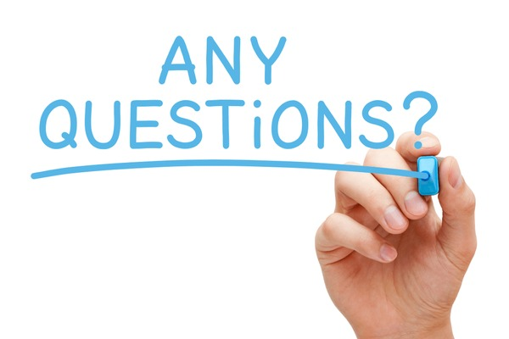

Slide 23


